Slide 1
Enjoy Life at Work
Employees: Jessie S, Zach R, and Tanner C.

Slide 2
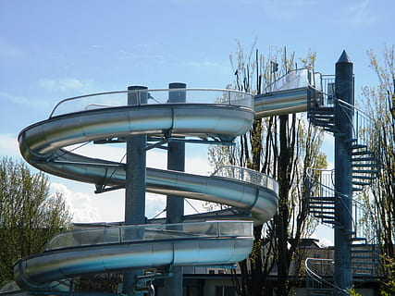
Double Helix Slide
Having 2 double helix slides will allow for employees to take a break and stretch their legs. Walk down the hall and slide down to the first floor to grab themselves a cup of coffee.

Slide 3
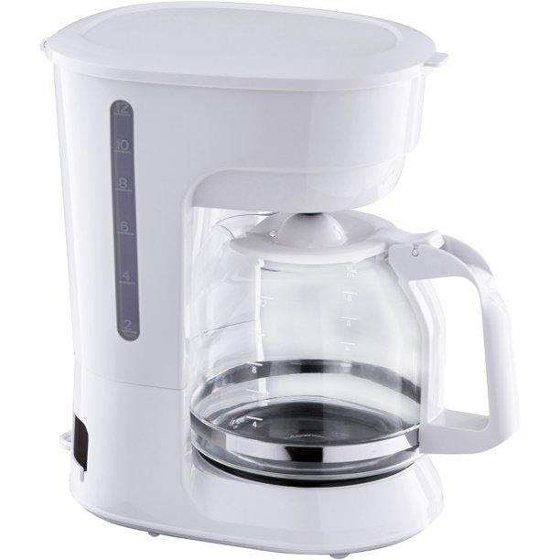
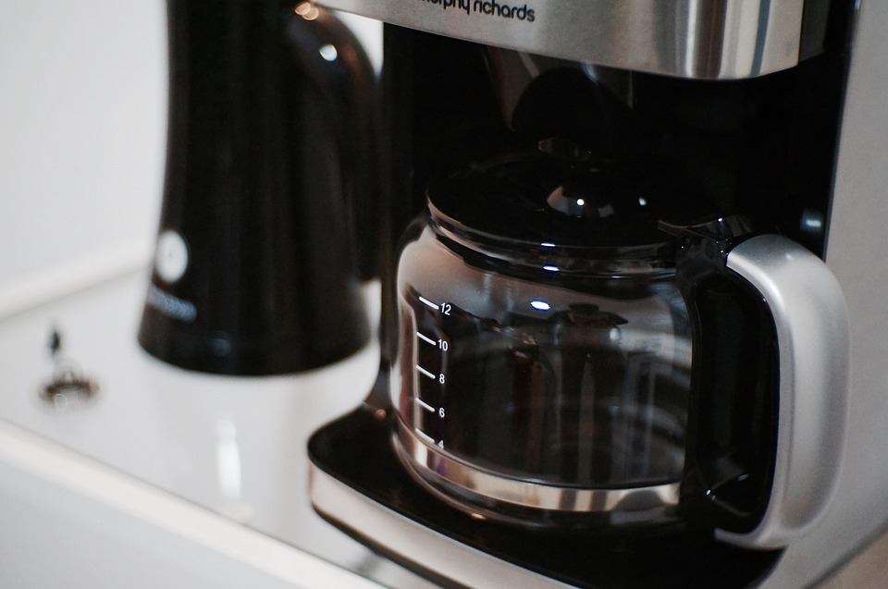
Coffee Machine
Fifteen coffee machines will permit employees to efficiently pour their drinks in a timely fashion and get back to work sooner.

Slide 4
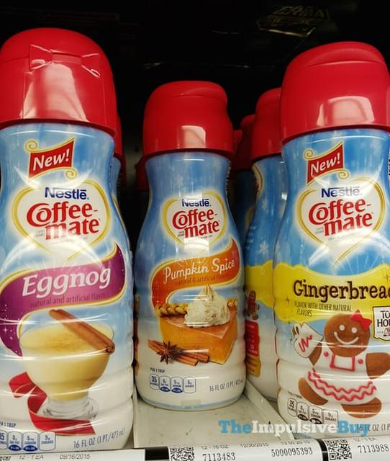
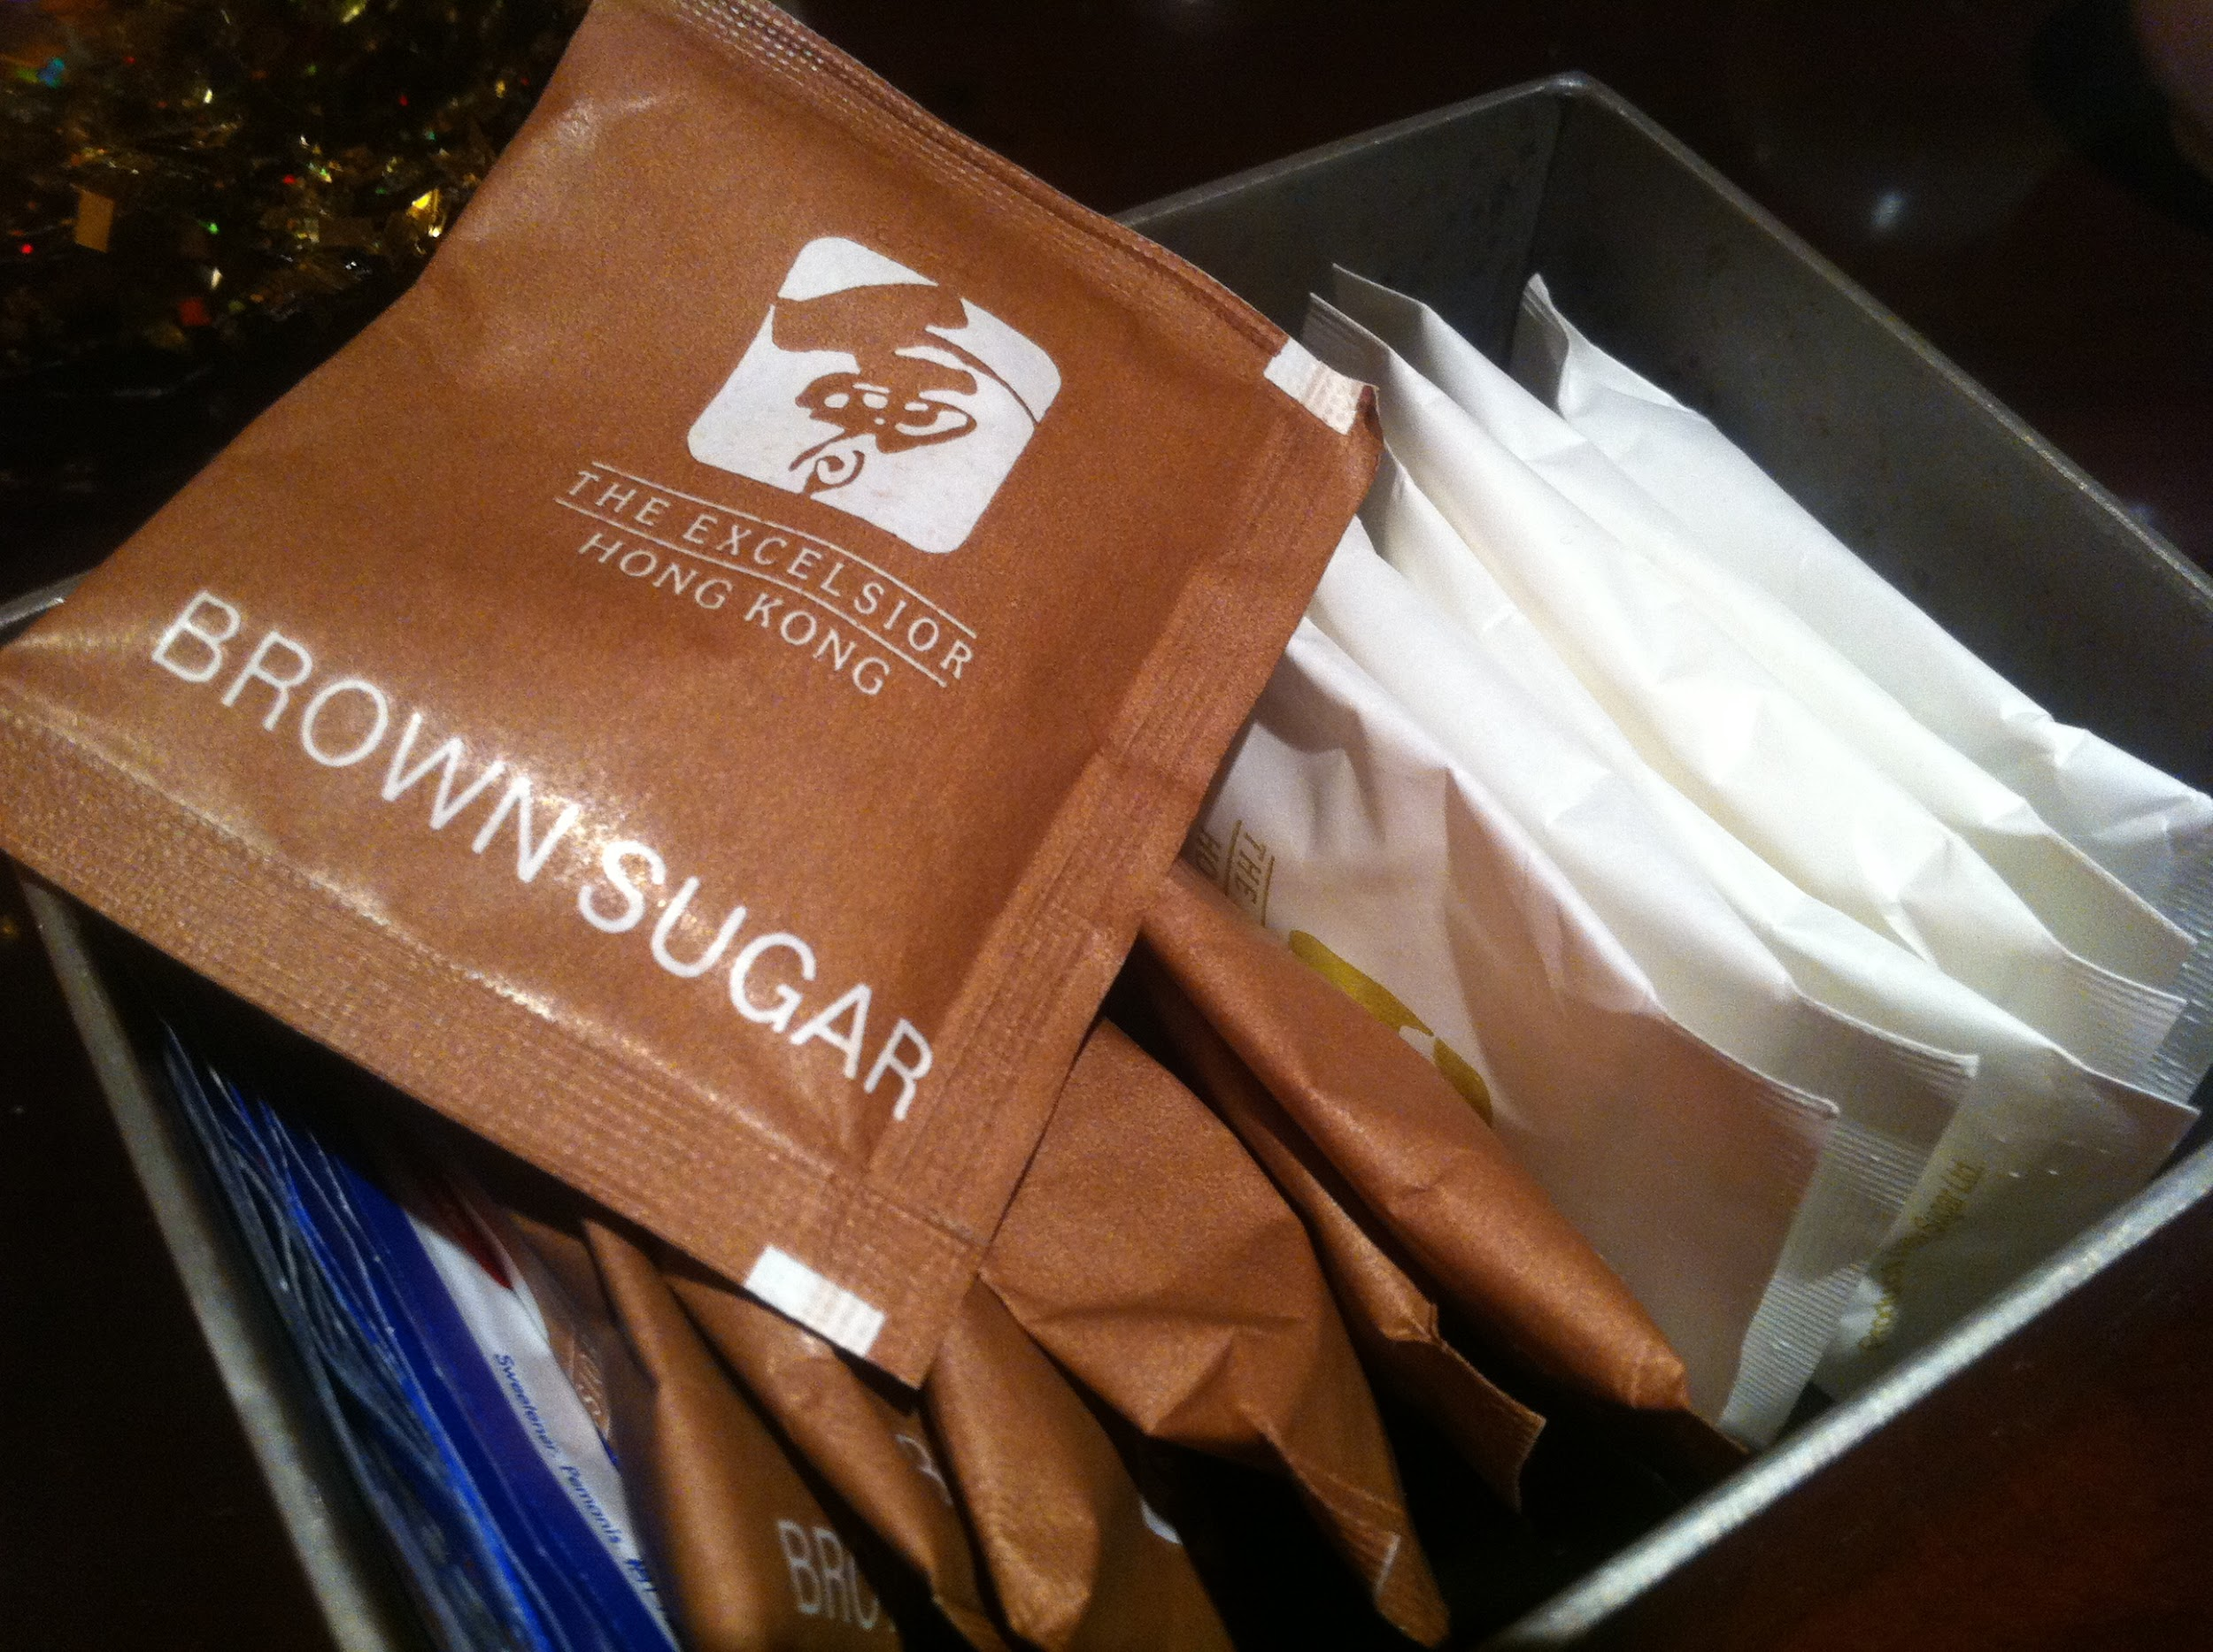
Sugar and Creamer:
By providing a variation of both sugar and creamer, individual employees will have the ability to dress their drinks to their liking.

Slide 5
